Slide 1
“It’s Not a Bug, It’s a Feature”
Advisor Meeting One

Slide 2
key decisions & achievements
Project: Bicycle Hire Planner
Technologies: Flutter, Firebase, Android Studio
Training: Team all watched Flutter Tutorials
Organization: Trello Board (Kanban Board & Epic Planning), Meetings Every Tuesday & Friday
Communications: Team Communications held through Slack
Work:
Repository with Flutter Project & Firebase Setup
Initial Epic and User Story Planning
UI Prototype Wireframe Design
Social: Planning Social Activities for Team Building

Slide 3
current challenges
Not Having Met Client
Unable to Clarify Requirements
Unable to Solidify Initial User Stories
Team Separation
Map API Selection & Research
Team Role Division
Dividing and Assigning Work

Slide 4
two weeks plan
Stakeholder Analysis
Finish Requirements Elicitation
Setup GitHub Workflow
Complete Epic One
Start Work on Epic Two

Slide 5
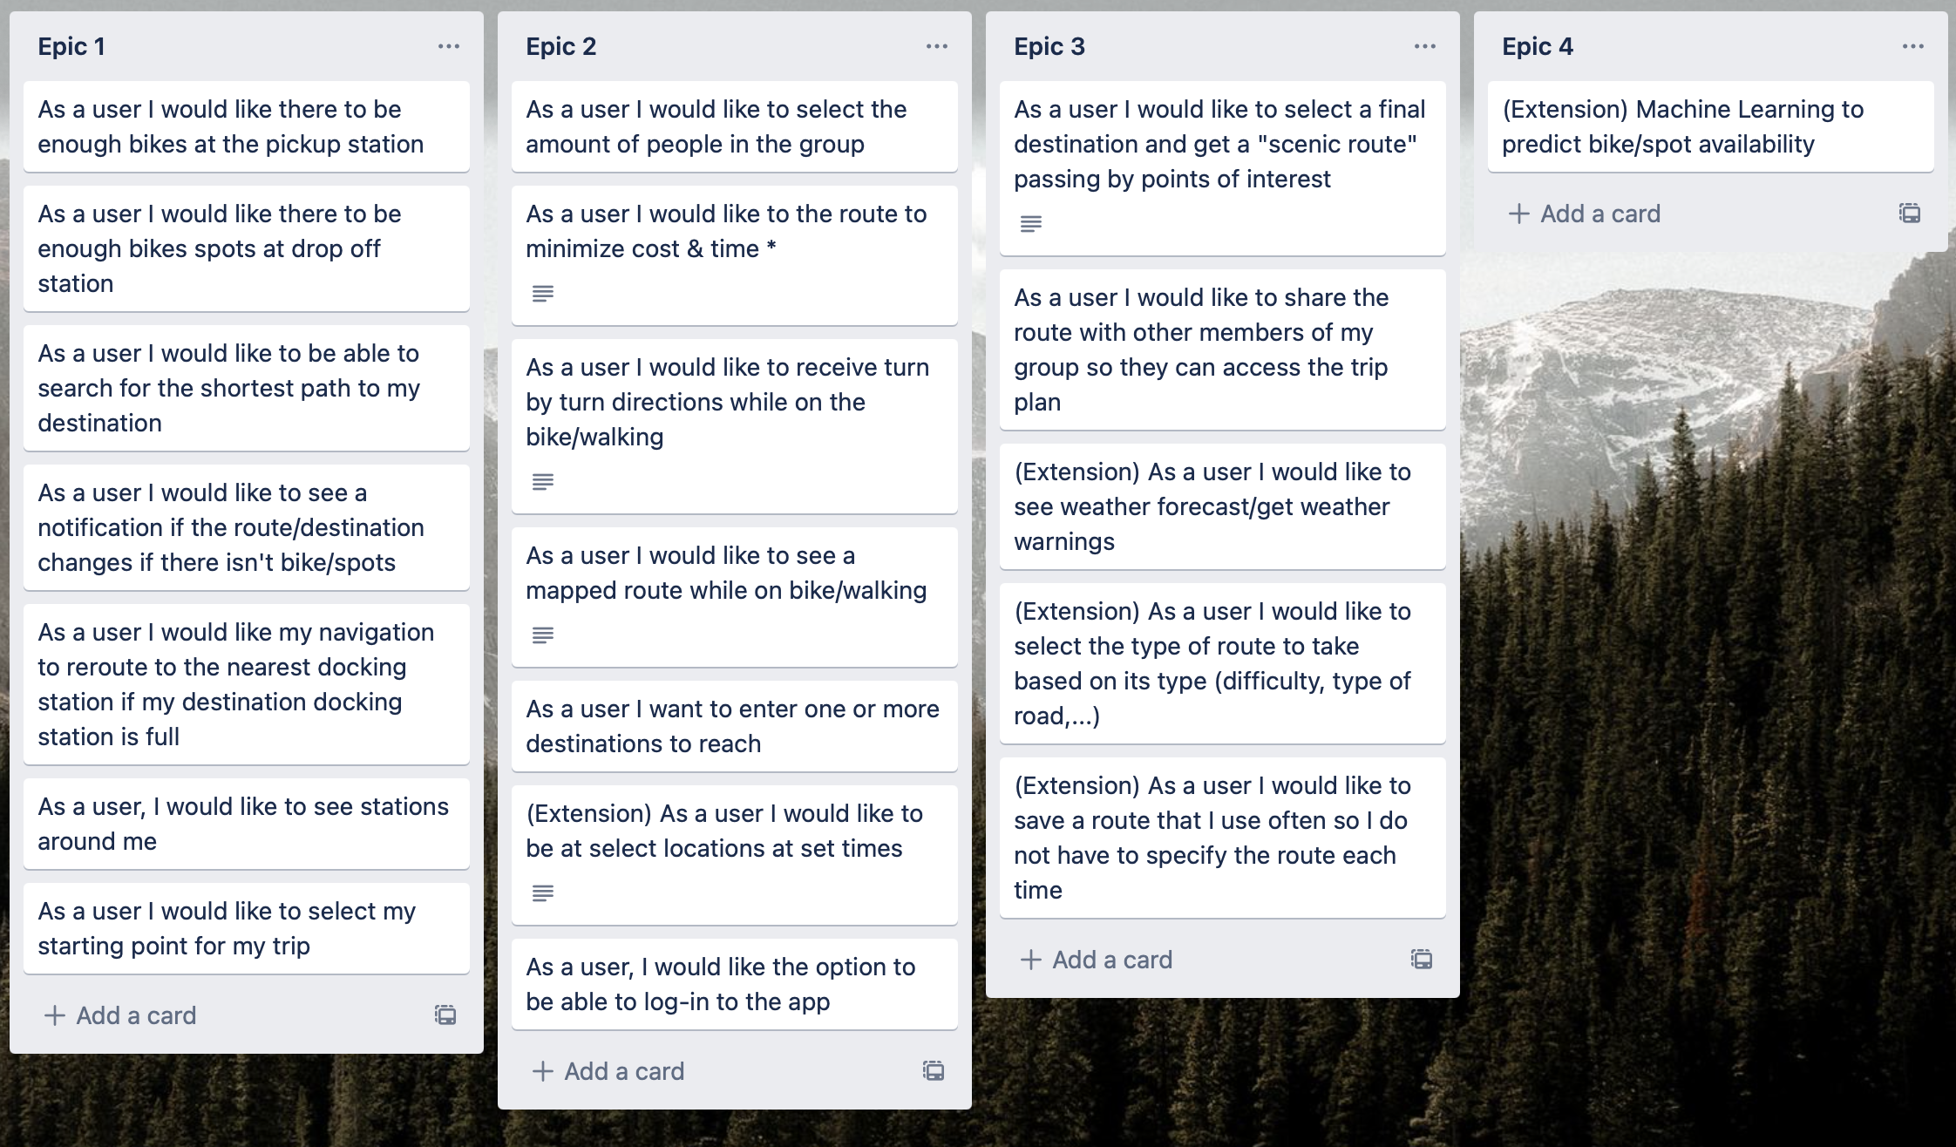
Epics and User Stories

Slide 6
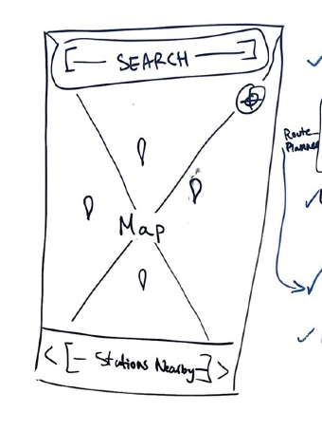
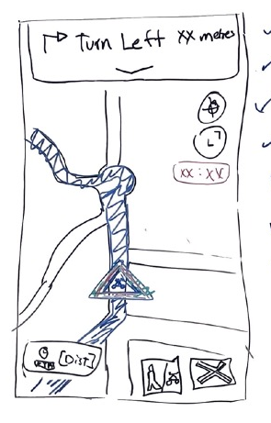
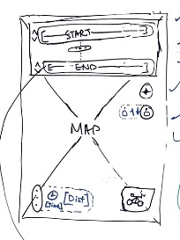
UI Wireframe Prototypes
Home Page
Navigation Page
Route Planning Page

Slide 7
The End

